Slide 1

How to approach epidemiological questions about infectious disease
Prof Cheryl Cohen
Centre for Respiratory Disease and Meningitis
National Institute for Communicable Diseases
Johannesburg, South Africa
cheylc@nicd.ac.za

Slide 2
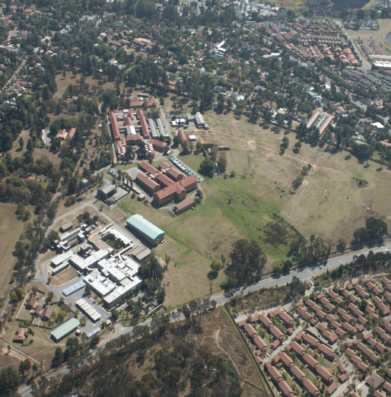
The National Institute for Communicable Diseases, Johannesburg, South Africa

Slide 3
The scenario
You are working in the national public health institute in an African Country
A cluster of 50 cases with severe respiratory illness is identified in the capital city of a country in South America – most cases are from the main hospital
Advanced sequencing techniques identify in 33 cases a novel respiratory virus which has not been previously identified
What are the main epidemiologic questions you would want to answer?

Slide 4
Early questions
Asses threat of this virus spreading beyond the borders
Does the virus spread from person to person? Or is it from a zoonotic source?
If it spreads – how efficiently?
Mode of transmission
How widespread is it?
Asymptomatic infections?
If it spreads how severe will it be?
What if it was a bloodborne pathogen – more or less formidable?
What if it had a 70% CFR?

Slide 5
The scenario
It becomes clear that the virus spreads efficiently from person to person
It is identified in multiple sites in Europe, Asia, USA
It is clear it will reach your country
You are preparing for the arrival of the new virus
What are the main epidemiologic questions you will want to answer?
Why?
What approach will you use to answer them?

Slide 6
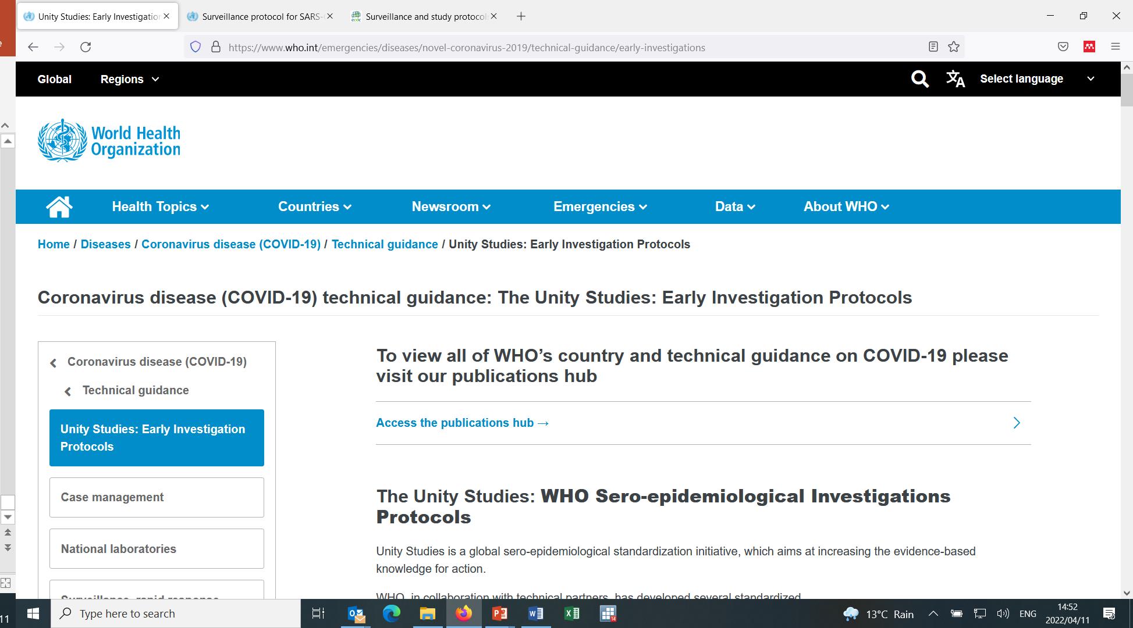
https://www.who.int/emergencies/diseases/novel-coronavirus-2019/technical-guidance/early-investigations

Slide 7
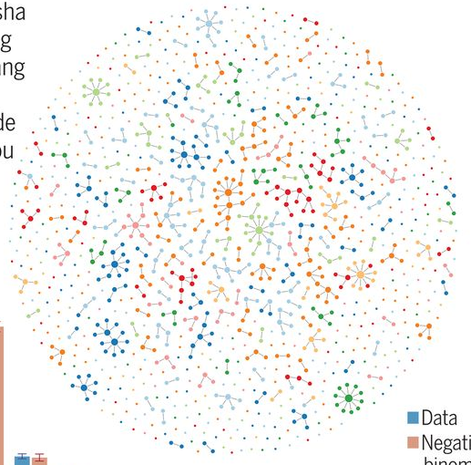
TRANSMISSION

Slide 8
BASIC REPRODUCTION NUMBER
The average number of secondary infectious cases produced by each infectious case in an entirely susceptible population

Slide 9
NET REPRODUCTION NUMBER
Average number of secondary infectious cases per individual in a population where not all individuals are susceptible

Slide 10
Herd Immunity Threshold (HIT)
Minimum prevalence of immune individuals in a population for stable transmission
(R=1)
Must exceed the herd immunity threshold to interrupt transmission
(R<1)
HIT=(R0-1)/R0

Slide 11
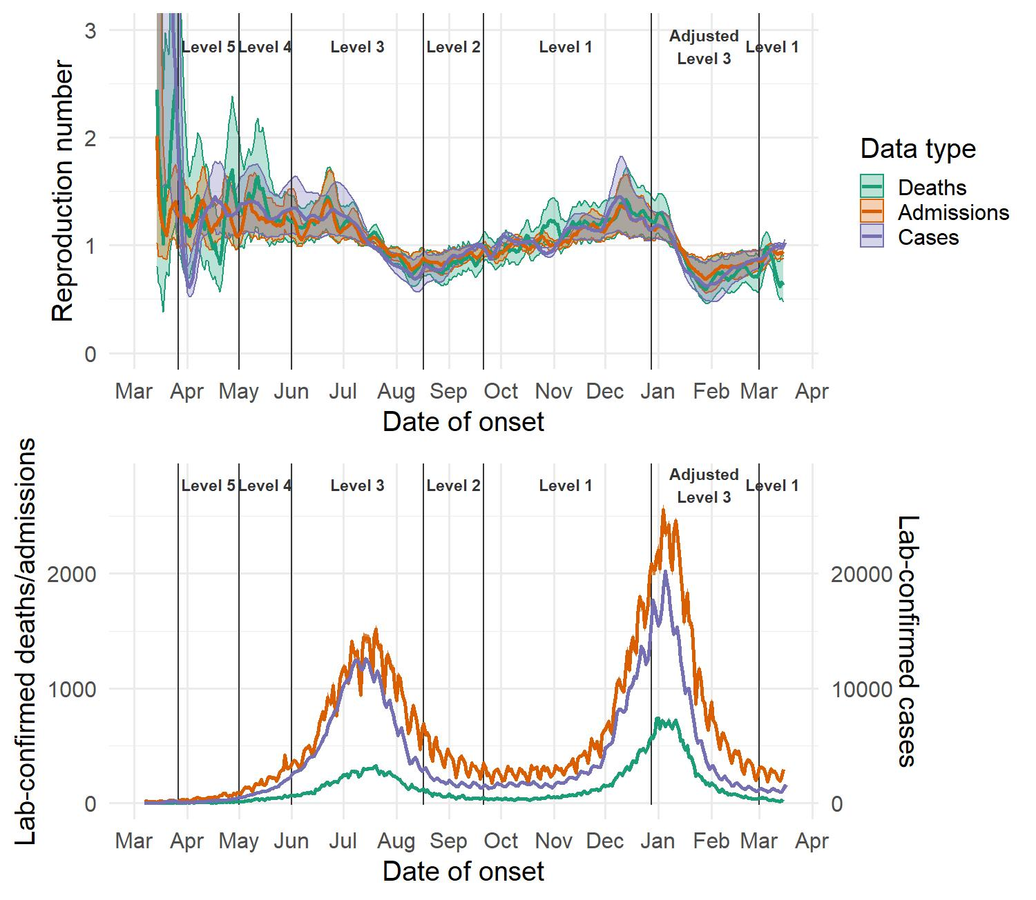
Upper panel: Estimated daily reproduction number (R), with 95% confidence intervals, South Africa (last date included in the estimation: 15 March). Lower panel: estimated number of laboratory-confirmed COVID-19 cases, hospital admissions, and deaths, by onset date with missing data imputed. The medians and 95% ranges for the imputed datasets are shown. Daily numbers of confirmed laboratory-confirmed COVID-19 cases in the bottom panel are shown on the right-hand y axis.

Slide 13


Slide 15
SEVERITY AND CLINICAL PRESENTATION
AND RISK GROUPS FOR SEVERE DISEASE

Slide 16

Jassat, Cohen, Tempia et al Lancet HIV 2021
Waasila Jassat
Age
Non-communicable
comorbidities
TB
HIV
Multivariable analysis of factors associated with in-hospital mortality among laboratory-confirmed SARS-CoV-2 individuals admitted to hospital, 5 March 2020-27 March 2021, DATCOV, South Africa. (n=219,265)
Estimated prevalence of comorbid conditions for COVID-19 hospitalisations by age, 5 March 2020-27 March 2021, DATCOV, South Africa

Slide 17
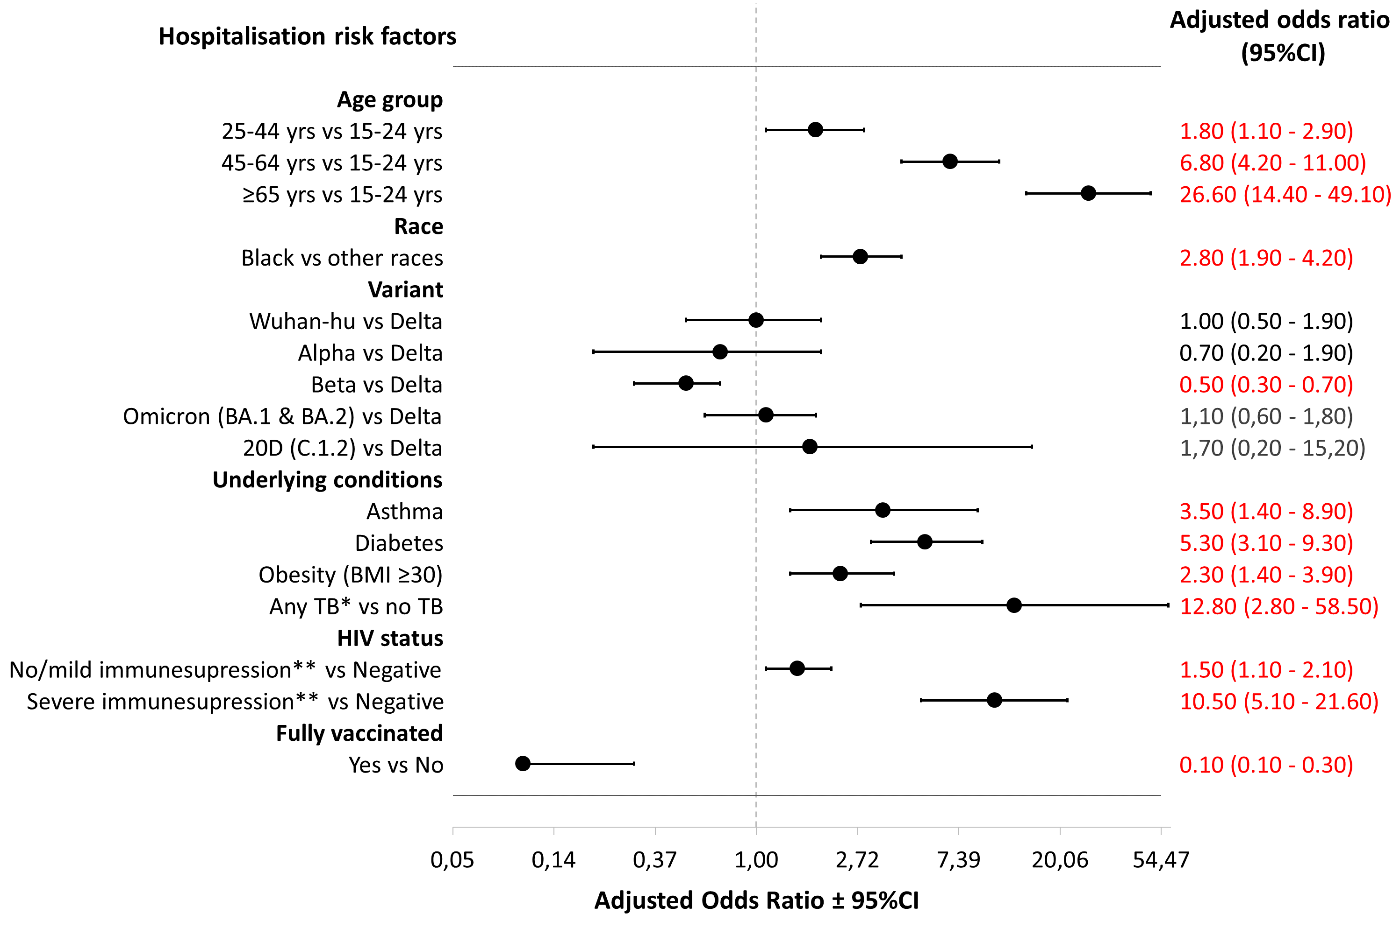
Increasing age, black race and underlying conditions were associated with COVID-19 hospitalisation in sentinel surveillance
Walaza et al OFID 2022
*Any TB= tuberculosis at any time (past and current)**No/Mild immune-compromise CD4 count >200/mm3, severe immune compromise CD4 count ≤200/mm³

Slide 19
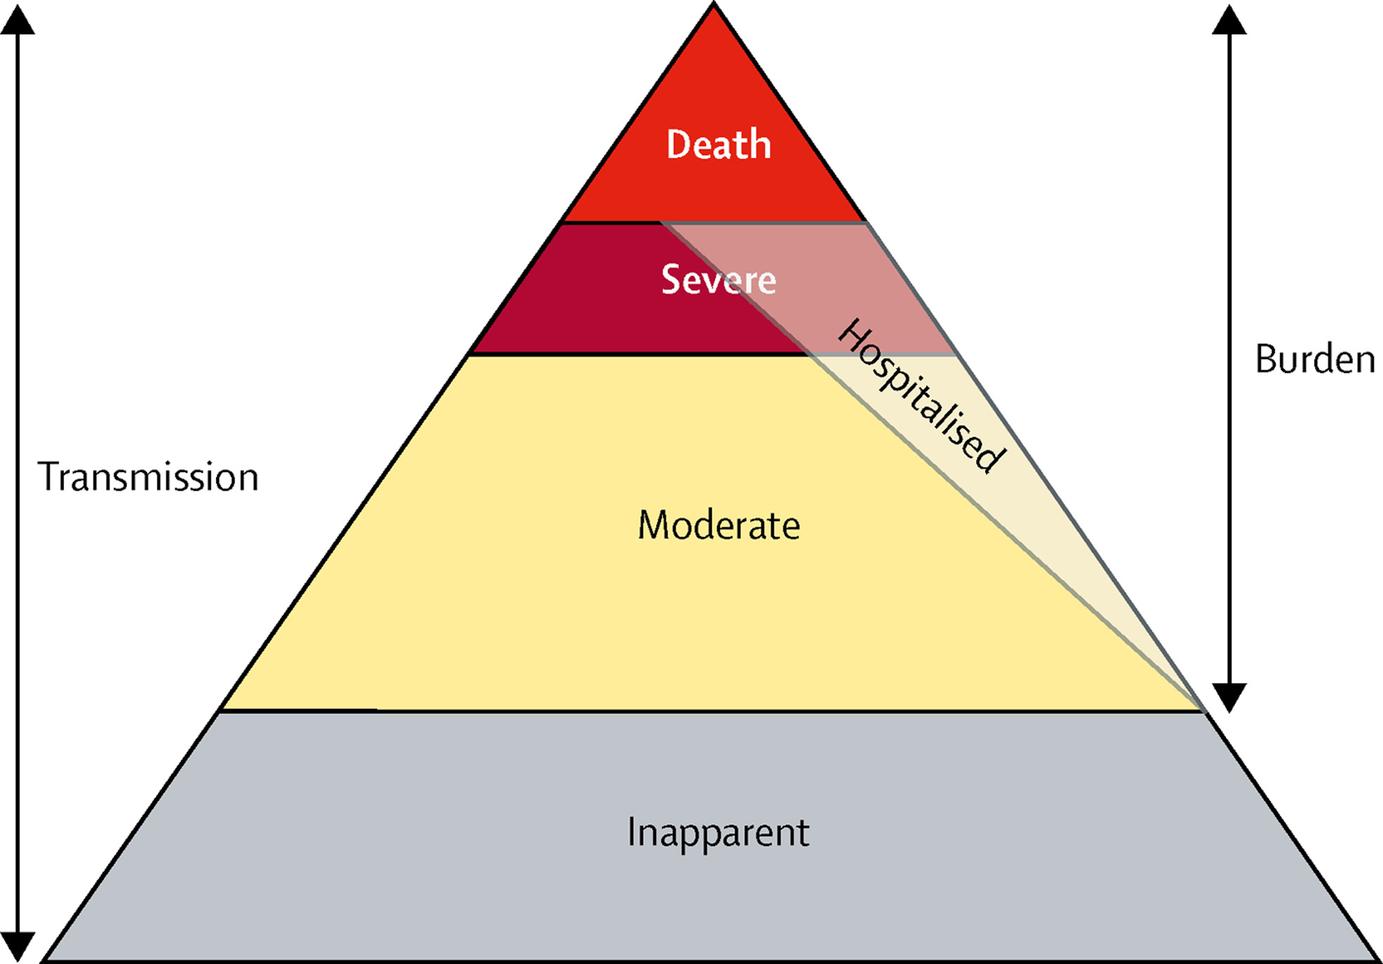
BURDEN OF DISEASE

Slide 20

SARS-CoV-2 seroprevalence by month and site, November 2020 - April 2021
On univariate analysis, individuals from Mitchell’s Plain were more likely to be positive for SARS-CoV-2 antibodies as compared to those from Klerksdorp (OR 1.2; 95% CI: 1.1-1.6; p<0.001).
Individuals who had specimens collected in January 2021 (OR 8.6; 95% CI: 3.0-24.3, p<0.001) were more likely to be positive for SARS-CoV-2 antibodies as compared to individuals who had specimens collected in November 2020, likely reflecting epidemic progression over time and increasing number of infections during the second wave.
*Data for Pietermaritzburg from April 2021 still pending

Slide 21
SARS-CoV-2 seroprevalence by age group, November 2020 - April 2021
40.9%
average
The average seroprevalence across all three sentinel sites from November 2020 to April 2021 was 40.9% (2723/6663).
Age was not associated with SARS-CoV-2 seroprevalence on univariate analysis.

Slide 22


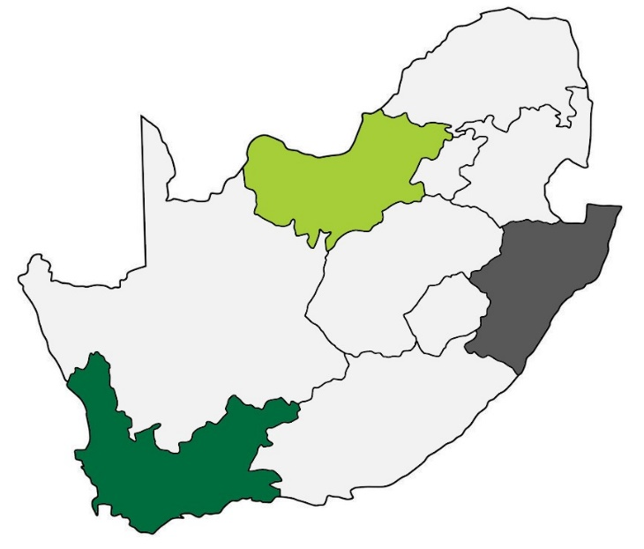

Nicole Wolter
Klerksdorp, North West Province
Pietermaritzburg, KwaZulu-Natal Province
Only 4-8% of all cases are diagnosed
Mitchell’s Plain, Western Cape Province
SARS-CoV-2 seroprevalence by site, HUTS study, November 2020 - April 2021
Wolter et al, in preparation

Slide 23


Ocean of deaths with influenza as the foam
Lone Simonsen
Notes:
Flu virus isolated 1933-34 (after Collins first paper!).
Flu Death rates increase in winter. Increase for all cause as well as pI, developed way to calculate excess over baseline.
Peaks for AC and PI are synchronised. About 40% of all excess deaths are causes other than PI.
– heart disease, DM, nephritis, cerebral haemorrhage, peurpeural conditions. NOT cancer or non resp tb. Suggests that the reason only saw great increase in tb mort in 1918 was because this is when young adults were affected and this age group is affected by tb. Also same reason for peurpeural cause which was much increased in 1918.
{Collins, 1951 389 /id}
Identified trend in declining PI mortality from 184/100000 in 1900-04 to 100 in 1937. then steeper decline until 1950 (34/100000). Occurred n all geographic areas. For winter flu excess deaths – higher in the 10 years after the 1918 pandemic and then declined.

Slide 24
Excess mortality for assessment of COVID-19 severity
South Africa reported excess deaths 172/100,000 population (vs USA (319), India (38)
Weekly excess deaths, South Africa, 29 December - 14 June 2022
Reported deaths 32% of excess deaths
Provincial range 11% (rural) to 68% (W Cape)
Excess COVID deaths March-July 2022 (5th wave) = 26 562
Annual influenza associated deaths 11 536 (6390–20 305)
Black line shows the weekly number of deaths
Orange/blue lines shows the number predicted from historical data with bounds of uncertainty – a lower bound and upper bound
Source: MRC Burden of Disease Research Unit
Notes:
Accounting for non reporting one of the highest in the world

Slide 25
VACCINE PERFORMANCE

Slide 26
Estimated VE against SARS-CoV-2 infections and hospitalization
Test-negative case control study of SARS-CoV-2 vaccine effectiveness against hospitalization Nicola Chiwandire
 | Pfizer |  | Johnson & Johnson
Entire period | Crude OR (95% CI) | Adjusted OR (95% CI)# | Crude OR (95% CI) | Adjusted OR (95% CI)&
Not vaccinated | Reference | Reference | Reference | Reference
Fully vaccinated | 0.42 (0.29 – 0.60)*** | 0.45 (0.29 – 0.69)*** | 0.68 (0.44 – 1.03) | 0.88 (0.53 – 1.45)
Partially vaccinated | 1.36 (1.03 – 1.80)* | 1.00 (0.72 – 1.39) | 0.83 (0.25 – 2.76) | 0.65 (0.11 – 3.84)
1 April ’21 to 31 Oct ‘21
Not vaccinated | Reference | Reference | Reference | Reference
Fully vaccinated | 0.13 (0.05 – 0.35)*** | 0.16 (0.05 – 0.47)** | 0.52 (0.27 – 1.01) | 0.60 (0.28 – 1.29)
Partially vaccinated | 1.48 (1.08 – 2.05)* | 0.85 (0.58 – 1.24) | 0.89 (0.21 – 3.74) | 0.35 (0.03 – 3.86)
1 Nov ’21 to 28 Feb ‘22
Not vaccinated | Reference | Reference | Reference | Reference
Fully vaccinated | 0.77 (0.53 – 1.14) | 0.68 (0.43 – 1.08) | 0.84 (0.52 – 1.36) | 0.79 (0.45 – 1.38)
Partially vaccinated | 0.95 (0.53 – 1.69) | 1.07 (0.56 – 2.04) | 0.63 (0.07 – 5.66) | 1.13 (0.07 – 17.33)
*p < 0.05, **p < 0.01, ***p < 0.001
# Adjusted for age, sex, race, week of admission, HIV status and province
& Adjusted for age, sex, race, HIV status and province
1 April to 31 Oct 2021 period includes the Beta and Delta variants
1 Nov 2021 to 28 Feb 2022 period includes the Omicron variant
Notes:
Adjusted VE
55%
84%

Slide 27
VIRAL EVOLUTION

Slide 28
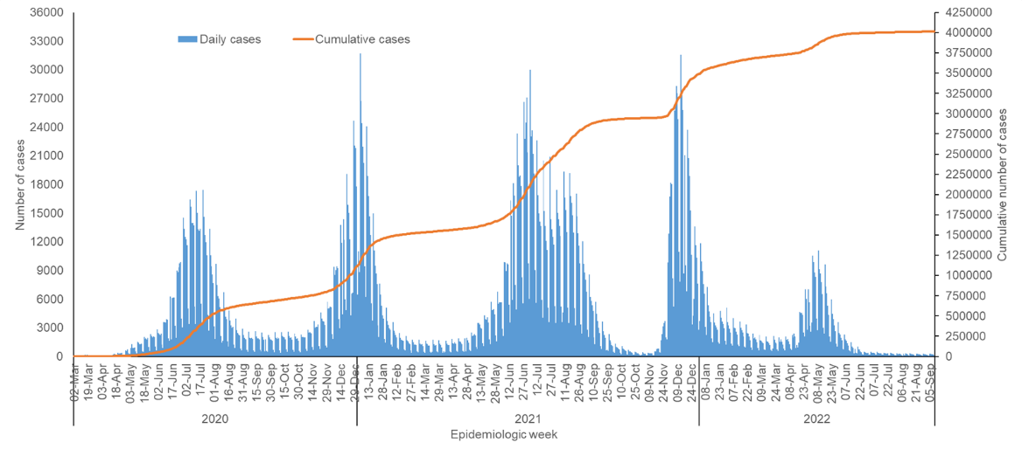
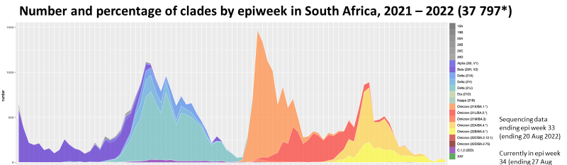

South Africa: lab-confirmed SARS-CoV-2 N=4 014 442 (10 September 2022)
Omicron BA.1/BA.2
Omicron BA.4/BA.5
Ancestral
Beta
Delta

Slide 29
Similar trends of circulating variants in national laboratory–based and sentinel surveillance
National genomic surveillance of South Africa (NGSA)
Number of SARS-CoV-2 genomes and detection rate* by specimen collection week, National genomic surveillance and syndromic sentinel surveillance**, South Africa, 1 March 2020 – 5 March 2022
Sentinel surveillance
Walaza et al OFID 2022
*Detection rate = proportion of SARS CoV-2 tests that are positive; **syndromic sentinel surveillance = SRI and ILI

Slide 30
BURDEN AND TRANSMISSION

Slide 31
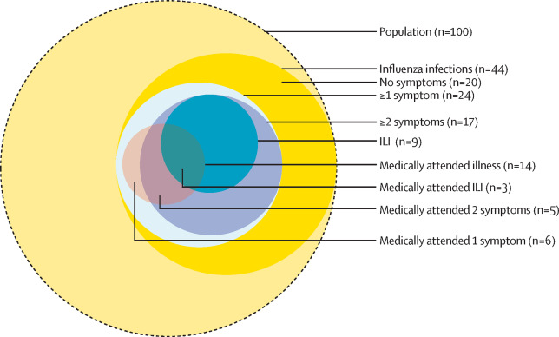
PHIRST-C builds on the platform of the PHIRST study
“Approximately half of influenza infections were symptomatic, with asymptomatic individuals transmitting influenza to 6% of household contacts. This suggests that strategies, such as quarantine and isolation, might be ineffective to control influenza.”
Estimated number of influenza infection episodes by symptoms and medical attendance per season in a population of 100 individuals
DOI:https://doi.org/10.1016/S2214-109X(21)00141-8
Lancet Global Health, 9(6) E863-E874, 2021
https://www.thelancet.com/journals/langlo/article/PIIS2214-109X(21)00141-8/fulltext

Slide 32
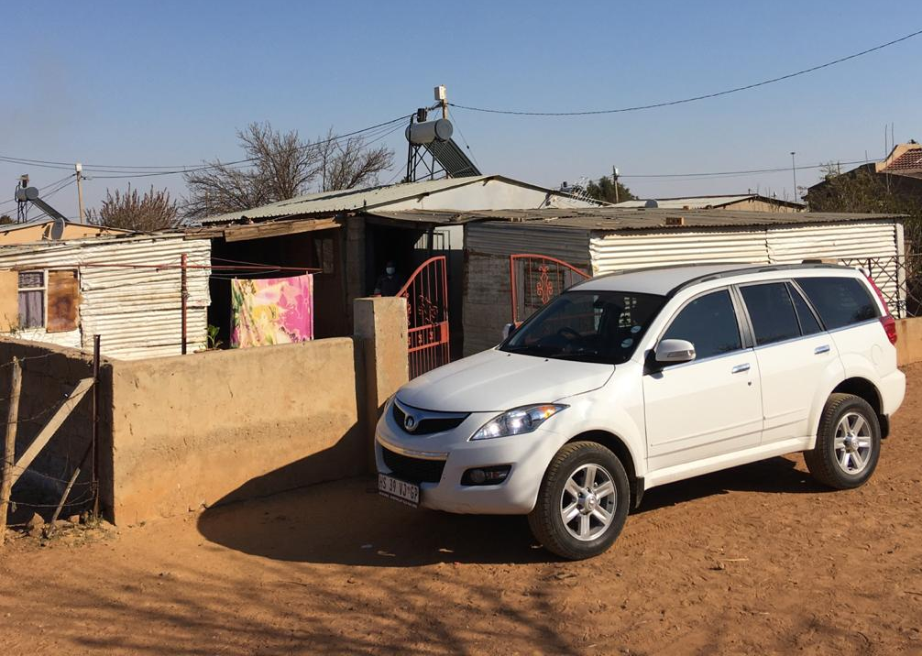
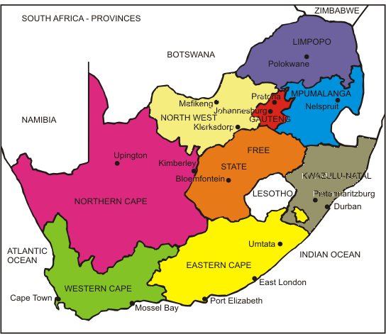
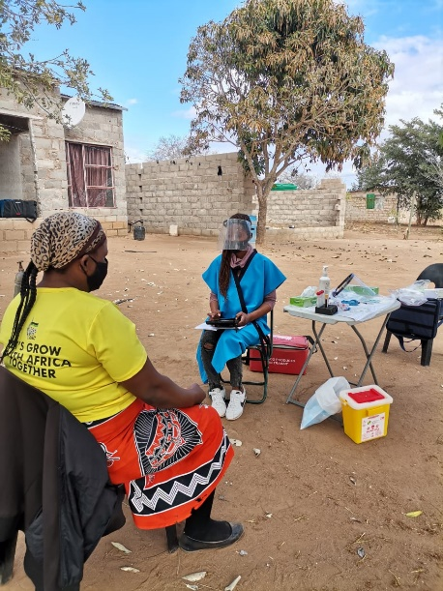
PHIRST-C study of SARS-CoV-2 burden and transmission
Prospective community cohort
Rural and Urban site
222 households – randomly selected
1200 individuals
Intense follow up - July 2020-August 2021 (14 months)
Twice weekly household visit
Mid-turbinate nasal swab
Seegene real-time rRTPCR – SARS-CoV-2
Symptoms
Healthcare seeking
Ongoing
Two monthly blood draw
ELISA Roche Elecsys – ant-N and anti-S
Cohen et al Lancet Global Health, 2021; Cohen et al Infl Other Resp Virus 2021; Cohen et al Lancet Infect Dis 2022
Notes:
Objectives and lancet images

Slide 33
PHIRST-C key findings
125,088 potential follow-up visits
115,759 (93%) swabs tested
62% (749/1200) ≥1 SARS-CoV-2 infection
<5% of infections diagnosed
15% (96/662) episodes symptoms
6 (6%) outpatient clinic
9 (9%) hospitalised
2 (2%) died
25% (213/856) of susceptible household contacts acquired infection
Cohen et al Lancet Inf Dis 2022
July 2020 - 28 August 2021
Notes:
<5%v of all infections diagnosed

Slide 34

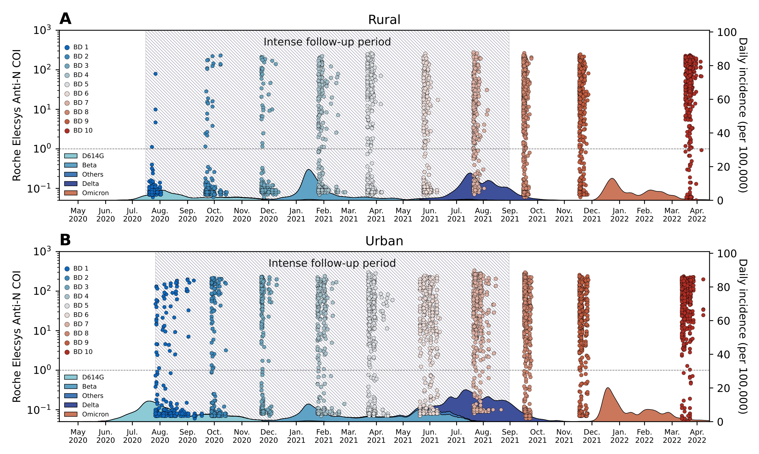

Infer Omicron infections using serial serologic data
Kaiyuan
Sun
Omicron
wave
Sun et al Nature Communications 2023
Notes:
Questions: Size of the Omicron wave
Effects of reduced testing vs actual severity
Used serum spanning the Omicron wave to infer infection attack rates – paramterised on Delta wave

Slide 35
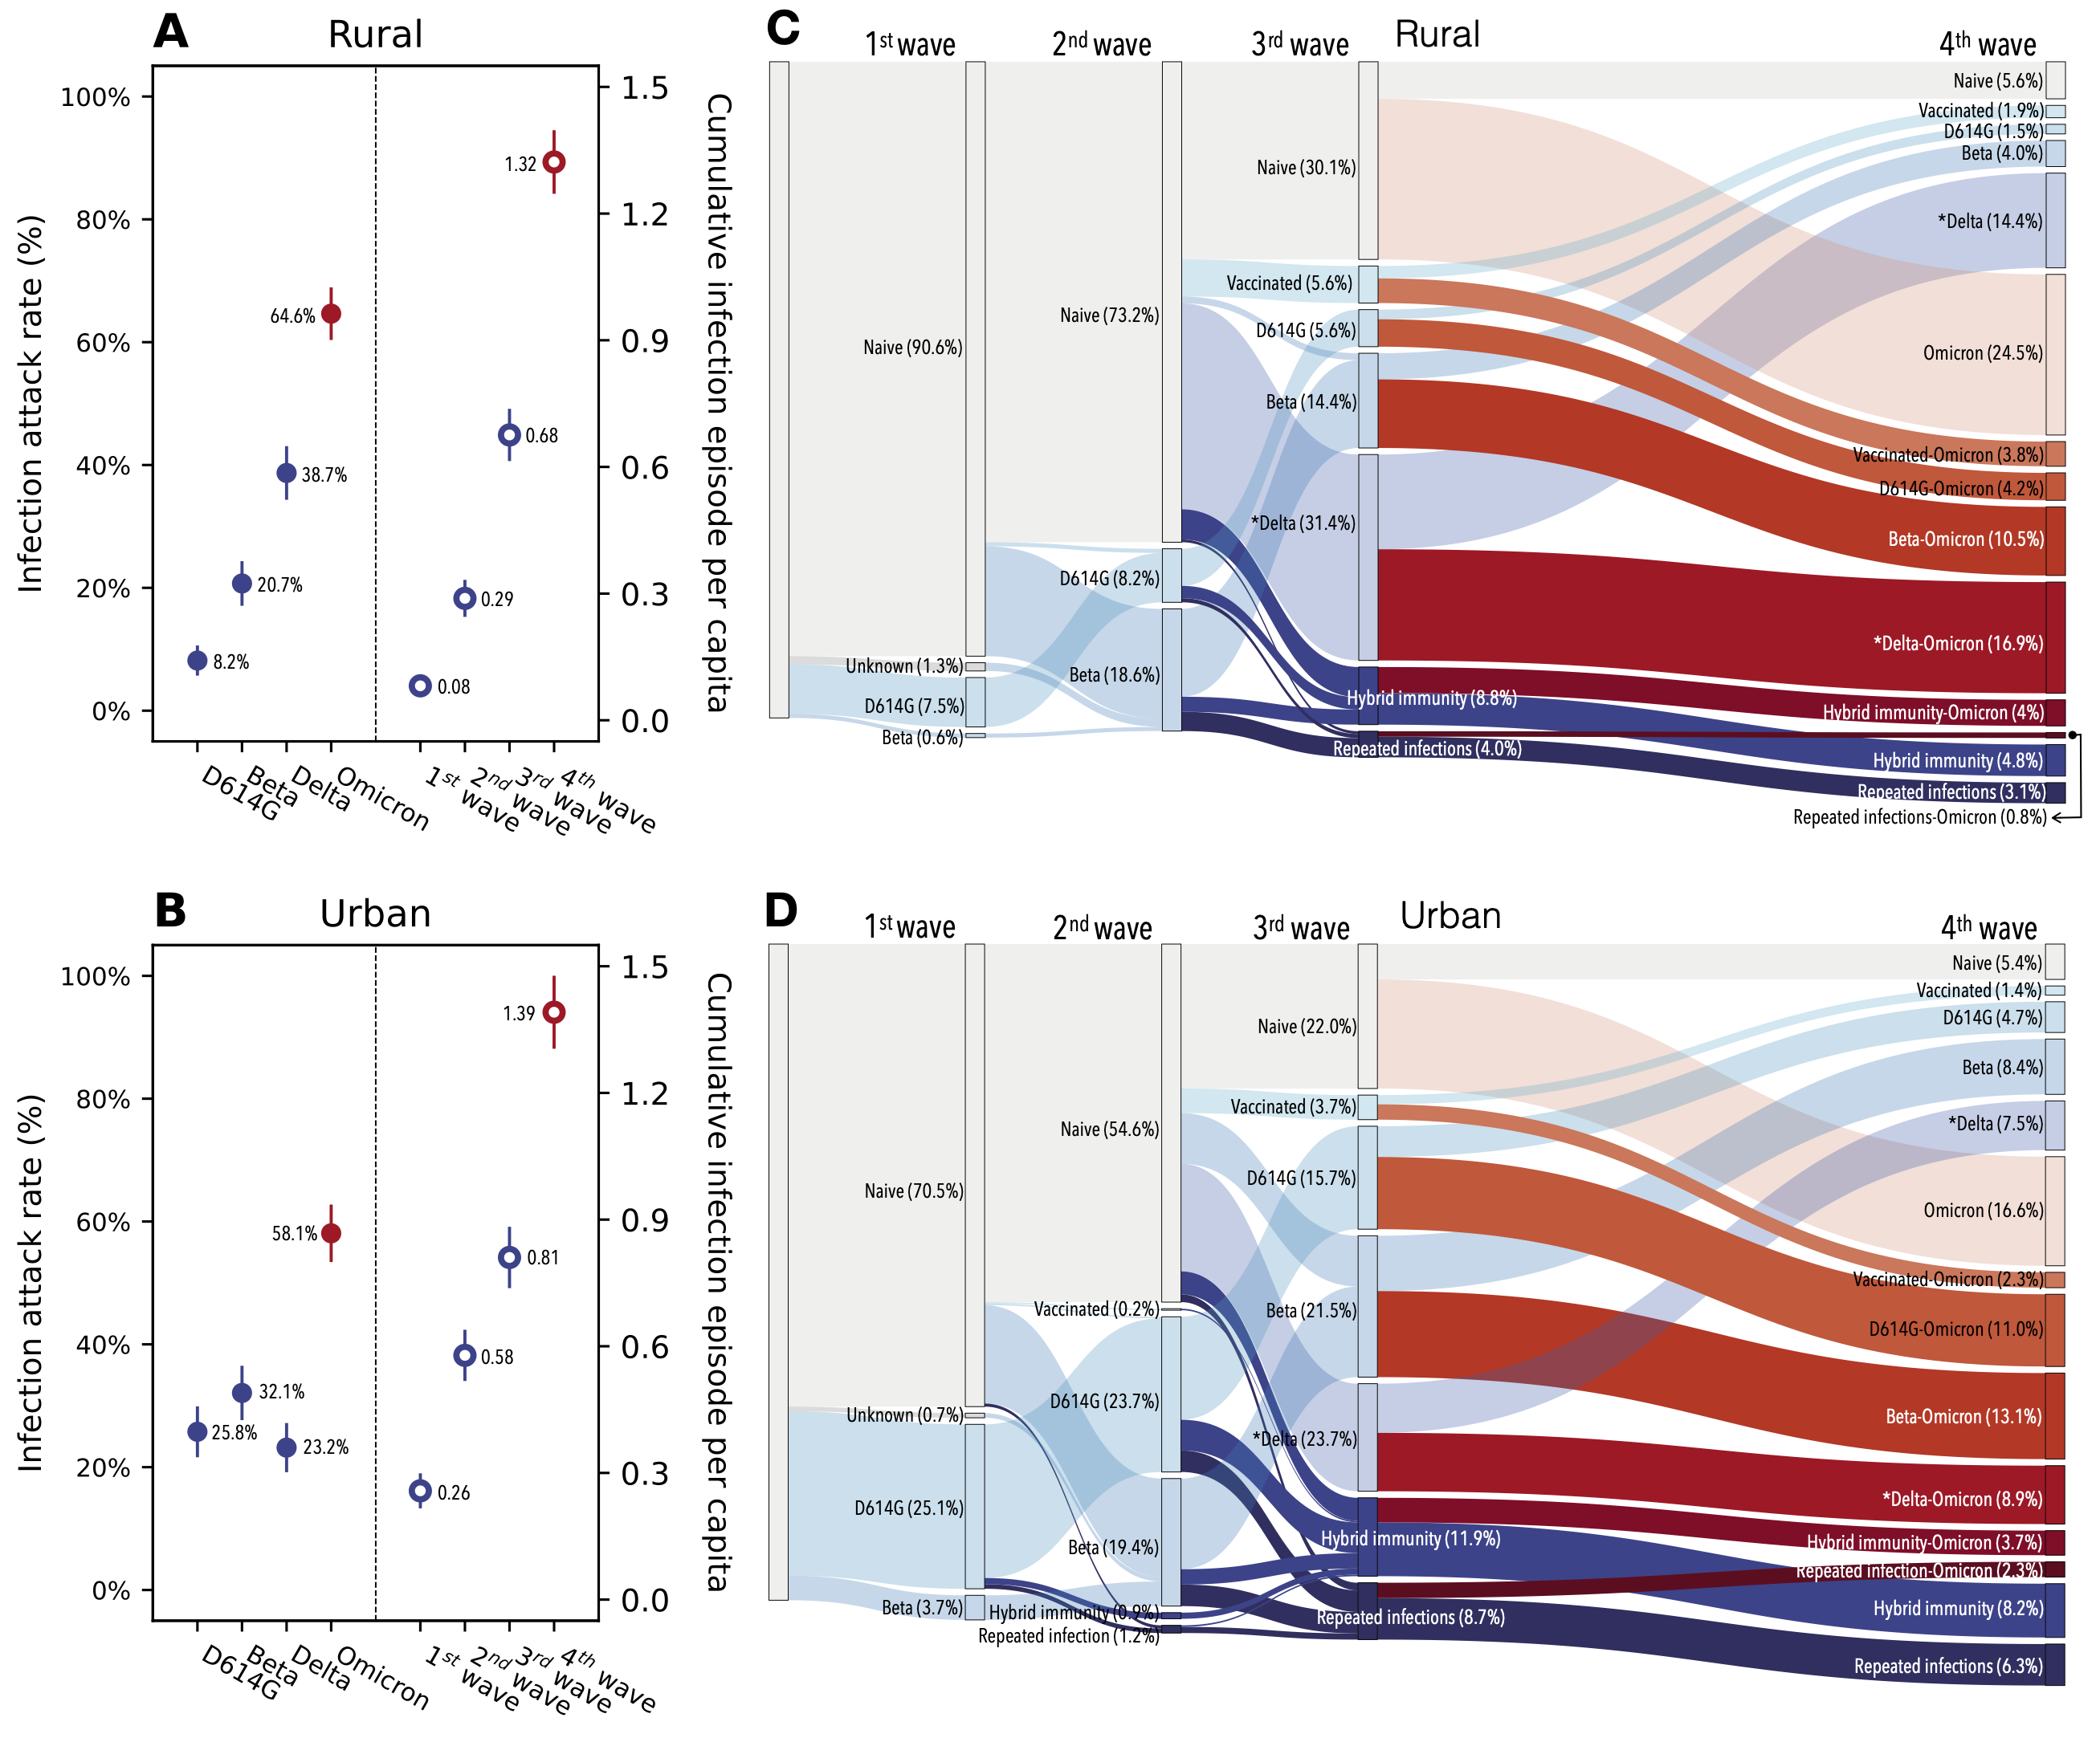
Attack rate %
Cumulative infections
Sankey diagram of different population immunologic exposures after successive waves
Blue Non-omicron
Red Omicron
Sun et al Nature Communications 2023
Notes:
Omicron BA.1/2 infection attack rates reached 65% (95% CI, 60% – 69%) in the rural cohort and 58% (95% CI, 61% – 74%) in the urban cohort, with repeat infections and vaccine breakthroughs accounting for >60% of all infections at both sites – despite prior infections being 68% and 81% - high levels of immunity
Prior to Omicron emergence – majority of infections primary
More than twice as likely to get infected during the Omicron BA.1/2 wave, compared to the Delta wave.
BA1 wave primary infections only 38% rural and 29% urban
Therefor average of 1.32 and 1.39 infections experienced by the end of the 4th wave – 2 years in
14 distinct categories of SARS-CoV-2 antigen exposure histories in the aftermath of the Omicron BA.1/2 wave, - fragmented immunologic landscape.
Few individuals (<6%) naïve to SARS-CoV-2 and no exposure history category represented over 25% of the population at either cohort site.
Vaccine coverage <20%
No longer a naïve population so data from during the pandemic of limited use – complex immune landscape helpful to guide decisions

Slide 36
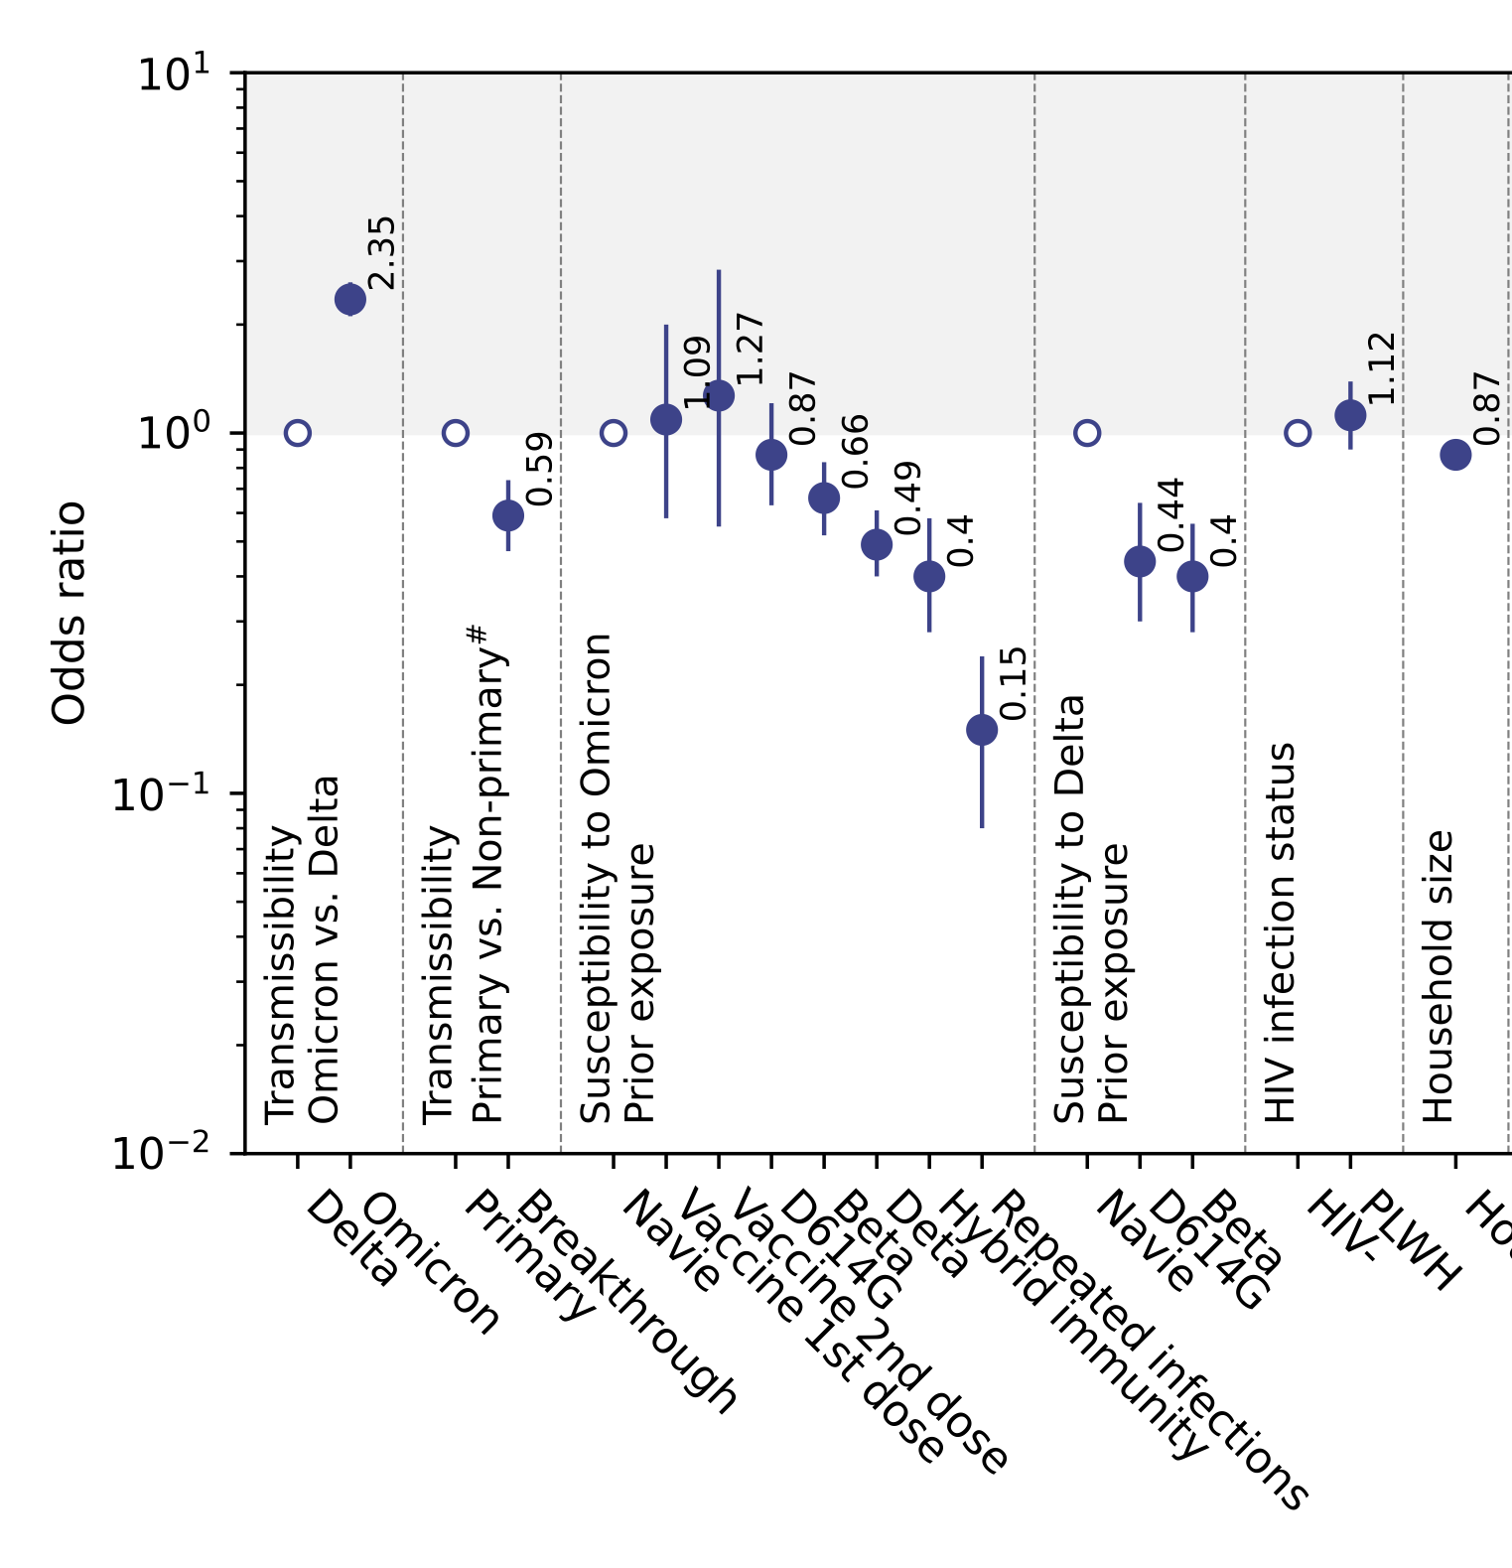
Factors associated with SARS-CoV-2 infection acquisition and transmission
Chain binomial model
Sun et al Nature Communications 2023
Notes:
Prior infection with the ancestral strain (with D614G mutation), Beta, and Delta variants provided 13% (95% CI, -21% – 37%) , 34% (95% CI, 17% – 48%), and 51% (95% CI, 39% – 60%) protection against Omicron BA.1/2 infection, respectively.
Hybrid immunity (prior infection and vaccination) and repeated prior infections (without vaccination) reduced the risks of Omicron BA.1/2 infection by 60% (95% CI, 42% – 72%) and 85% (95% CI, 76% – 92%) respectively.
Reinfections and vaccine breakthroughs had 41% (95% CI, 26% – 53%) lower risk of onward transmission than primary infections.

Slide 37
Impact of COVID-19 on children
HIV tests
ART initiation
ART collection
Decreased EPI vaccines coverage
Poisson segmented regression analysis before and after COVID-19 lockdown 65 clinics KwaZulu-Natal. Dorward et al Lancet HIV 2022

Slide 38
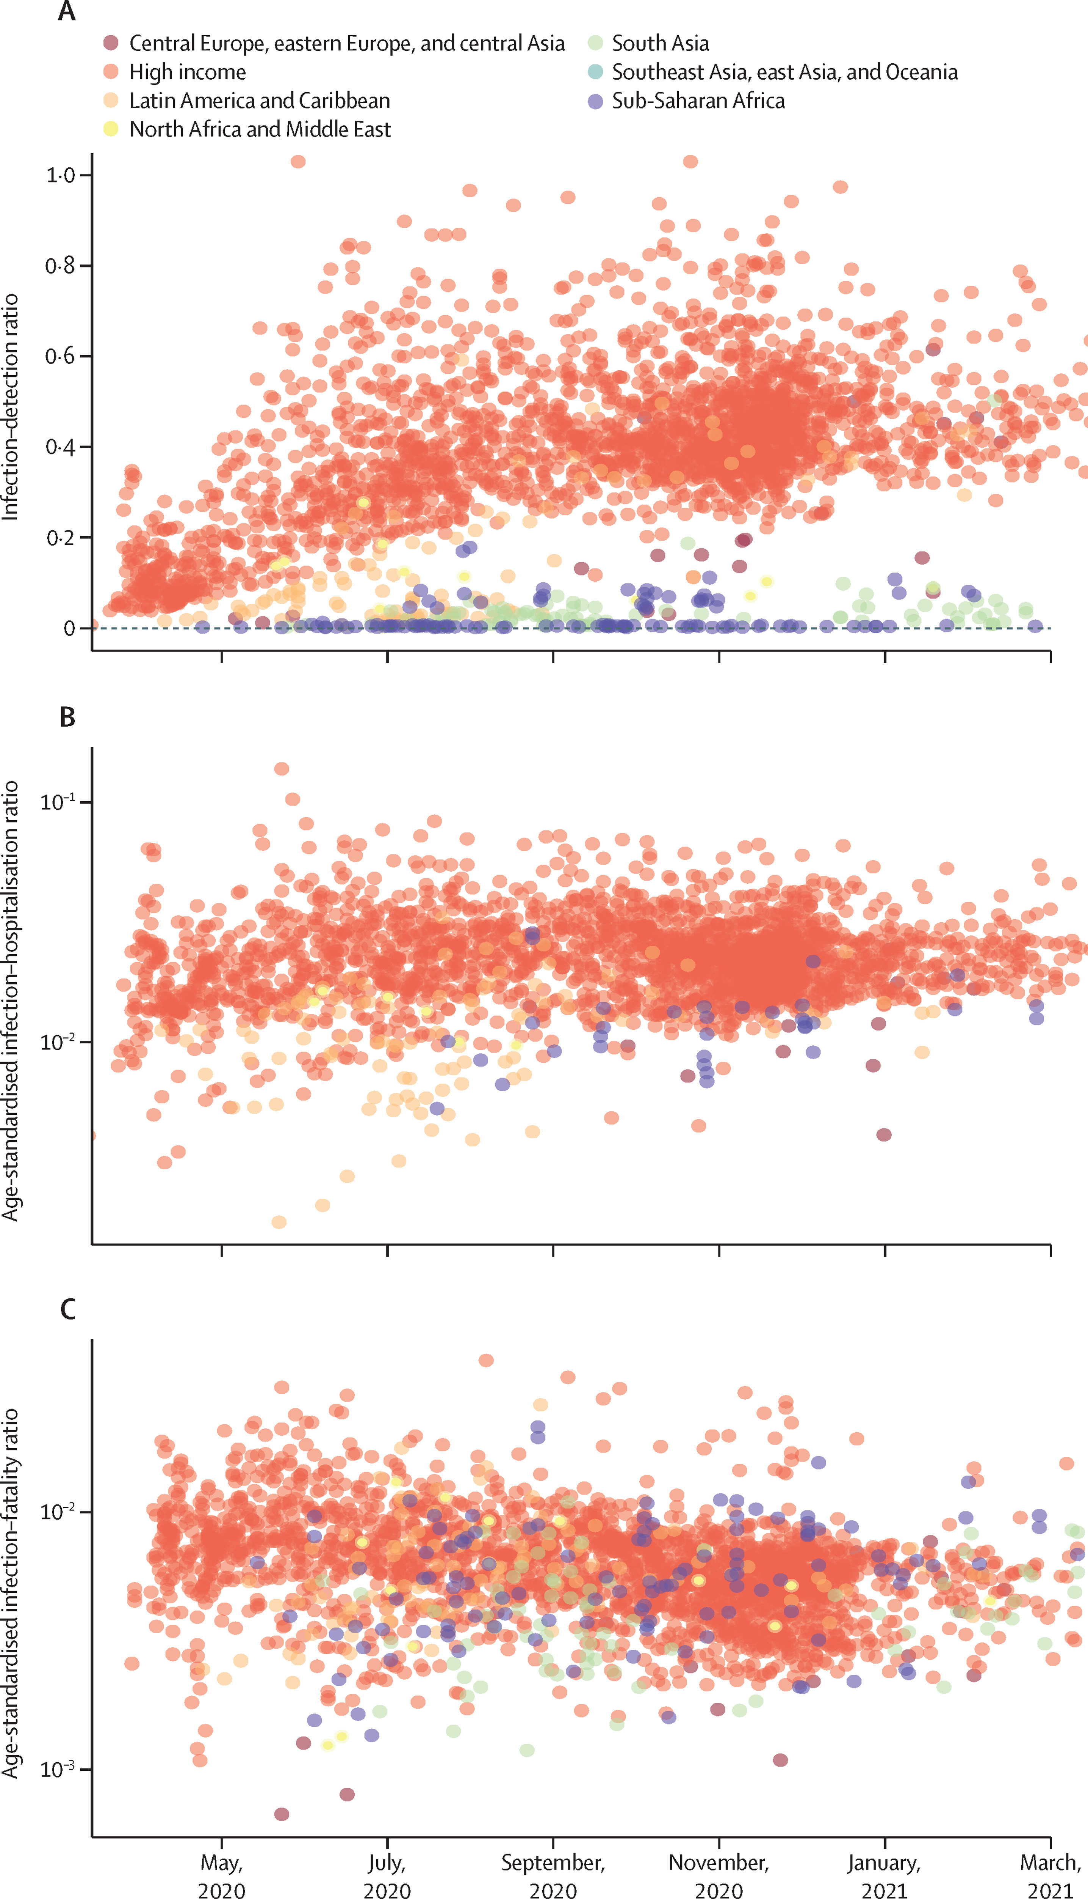
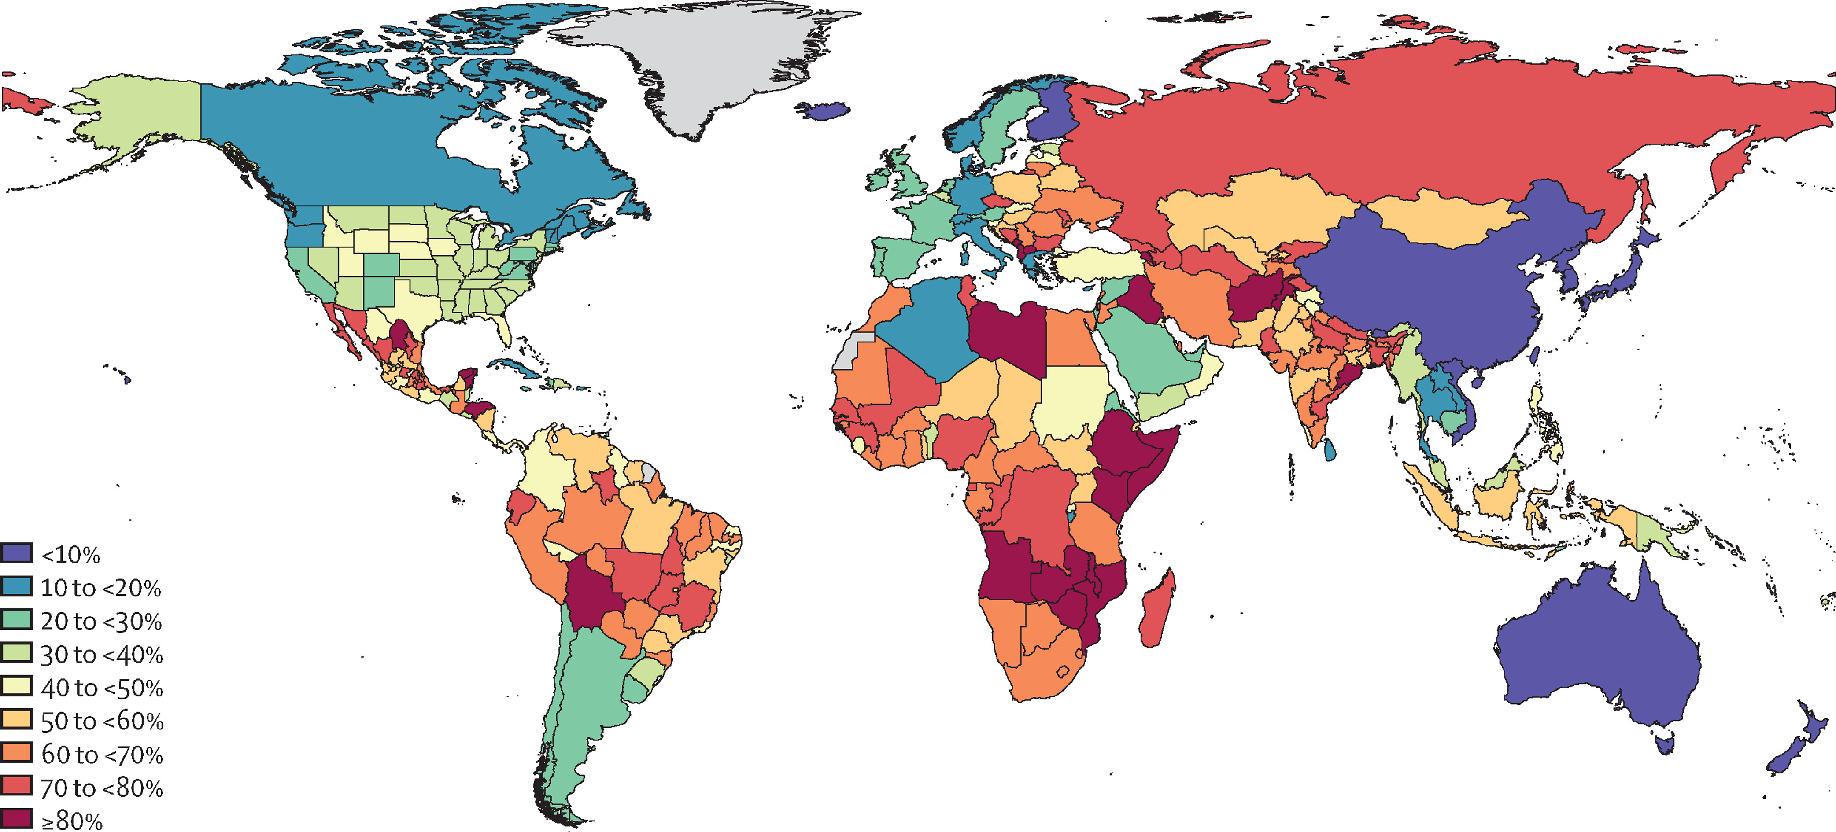
High SARS-CoV-2 attack rates in Africa
Infection–detection ratios
Age-standardised infection–hospitalisation ratios
Age-standardised infection–fatality ratios
Cumulative proportion of the population infected with SARS-CoV-2 at least once by Nov 14, 2021, by country and territory
Barber et al Estimating global, regional, and national daily and cumulative infections with SARS-CoV-2 through Nov 14, 2021: a statistical analysis The Lancet June 2022

Slide 39
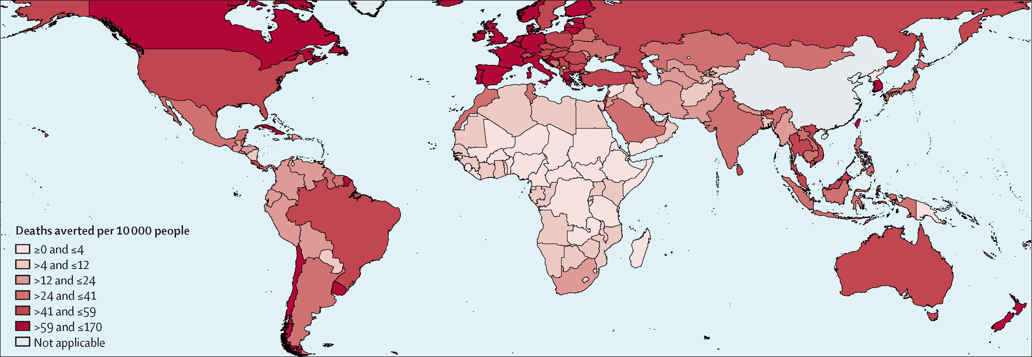
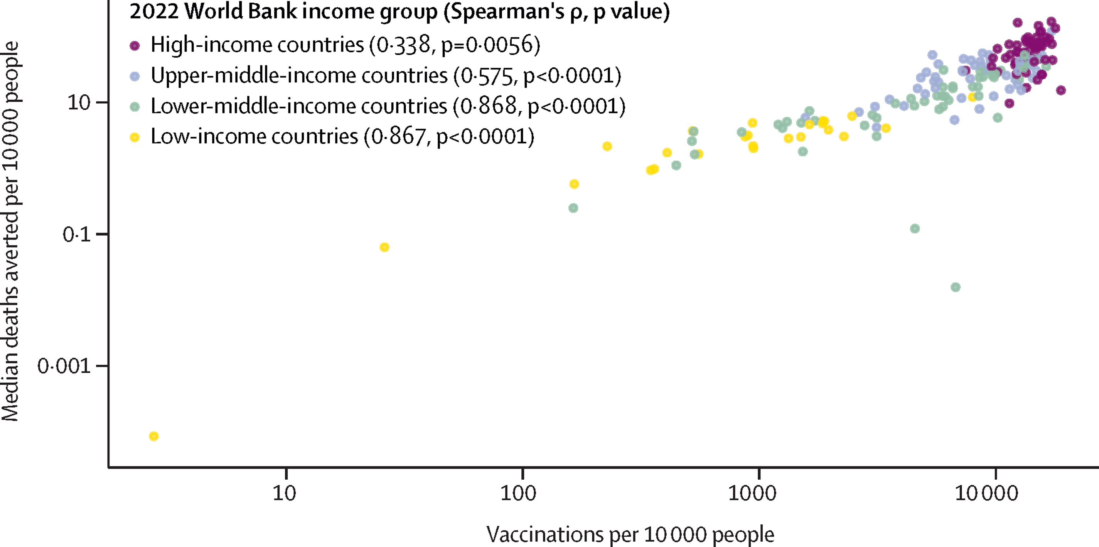
Lowest vaccine coverage in Africa and the vaccines came too late
Median deaths averted by vaccinations per 10 000 people by country in the first year of COVID-19 vaccination
Median deaths averted by vaccinations per 10 000 against vaccinations per 10 000 for each country
Global impact of the first year of COVID-19 vaccination: a mathematical modelling study Watson et al The Lancet Infectious Diseases September 2022

Slide 40
Trends in overall mortality: Agincourt, 1993-2021
Acknowledgement Chidzuwadziwa Kabudula, Kathleen Kahn, Stephen Tollman, Unpublished data

Slide 41
Conclusions
High burden of SARS-CoV-2 in Africa
Need for dedicated surveillance and research platforms
Many of these built on existing influenza platforms
High burden of negative impacts from NPIs
Important to monitor to guide future pandemic decision-making
Shift to endemicity
Need data on COVID-19 burden and attributable fraction vs other VPDs
Cost (and cost-effectiveness) of vaccines and delivery
Address hesitancy
Need for rational vaccine strategies and better more long lasting vaccines

Slide 42


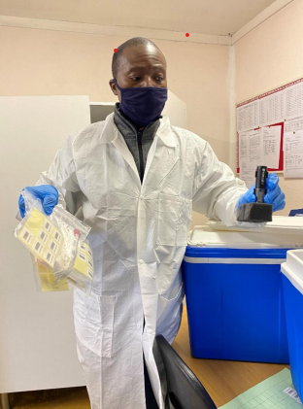
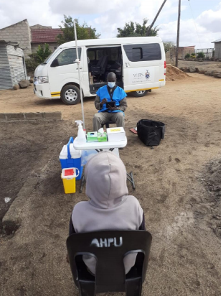



A Prospective Household study of SARS-CoV-2, Influenza, and Respiratory Syncytial virus community burden, Transmission dynamics and viral interaction in South Africa (PHIRST-C Study)
Klerksdorp Clinical Team
Khumbelo Ramutsindela
Matebejana Moroe
Thibelo Mokoena
Yoliswa Mphetshwa
Daniel Marungwane
Lesgeo Tshwaro
Nakedi Maredi
Tshepo Holele
Ipeleng Mokgwetsi
Keitumetse Nyatela
Othusitse Mosweu
Elizabeth Loeto
Mpho Seedie
Livhawani Tshikhudo
Lebogang Masetone
Busissiwe Masombuka
Masedi Bojani
Precious Khumalo
Nomthandazo Khanyile
Samkelisiwe Buso
Lerato Marettlwe
Motshewa Lichakane
Abram Nhlapo
Lorraine Thobakgale
Sizakele Mkhaliphi
Rebiditshe Leketi
Kgaugelo Kgasago
Tumelo Molontoa
Nalukege Kato-kalule
Data Management
Pattamukkil Abraham
Mbusiseni Ngema
Agincourt
Data management
Chodziwadzima Kabudula
Daniel Ohene-Kwofie
Brian Mdaka
Clinical team
Jacques du Toit
Floidy Wafawanaka
Shingi Chipungu
Sizzy Ngobeni
Solly Hlatshwayo
Agnesia Maleyana
Brian Khosa
Comfort Chibi
Percella Tebane
Nkosinathi Tshabangu
Sipho Dlalana
Ories Godi
Busi Masilela
Olivia Khosa
Portia Mabaso
Mildred Mashego
Akani Nkuna
Rose Bendane
Meriam Lubisi
Fortunate Ngobeni
Ngonidzashe Ngwarai
Investigators
NICD: Cheryl Cohen, Anne von Gottberg, Jocelyn Moyes, Jinal Bhiman, Nicole Wolter, Mignon du Plessis, Amelia Buys, Jackie Kleynhans, Thulisa Mkhencele, Sibongile Walaza
Agincourt: Kathleen Kahn, Stephen Tollman, Xavier Gómez-Olivé
Perinatal HIV Research Unit (PHRU): Neil Martinson, Limakatso Lebina
Centers for Diseases Control and Prevention (CDC), USA: Stefano Tempia, Meredith McMorrow, Fatimah Dawood
Fogarty International Center, National Institutes of Health, Bethesda, USA: Cecile Viboud and Kaiyan Sun
Institute for Scientific Interchange, Torino, Italy: Ciro Cattuto, Michele Tizzoni, Laura Ozella, Laetitia Gauvin
Advisory committees
Scientific committee: Ben Cowling (Division of Epidemiology and Biostatistics, Hong Kong University), Kanta Subbarao (Director of WHO collaborating Centre for Reference and Research on influenza, University of Melbourne Australia), Juliet Pulliam (Director of SACEMA, University of Stellenbosch), Melissa Rolfes (CDC), Mosa Moshabela (Dean and Head of School of Public Health & Nursing at UKZN)
Safety committee: Andrew Whitelaw (NHLS), June Fabian (Wits Donald Gordon Medical Centre Wits University), Jennifer Verani (CDC), Lindiwe Qwabe (Community representative Agincourt site), Banele Faku (Community representative Klerksdorp site), Saheen Methar (Infection Control Africa Network (ICAN) and University of Stellenbosch)
Laboratory teams
CRDM: Maimuna Carrim, Cardia Fourie, Naume Tebeila, Retshidisitswe Kotane, Azwifarwi Mathunjwa, Thabo Mohale, Lorens Maake, Cayla Reddy, Nokuthula Linda, Noxolo Ntuli, Boitshoko Mahlangu, Boitumelo Mathiba, Khululiwe Gigaba, Malusi Ndlovu, Nkosingiphile Thabete, Sam Yongama, Zenzile Tshabalala, Nthabeleng Makakole, Ronewa Madzivha, Noluthando Duma, Charlotte Yaldwyn
CHIVSTI: Thandeka Moyo, Frances Ayres, Zanele Molaudzi, Heena Ranchod, Lillian Makhathini, Penny Moore, Beverley Singh, Zinhle Brukwe, Rivashni Jagaroo
FUNDING – US CDC
In memory of Solly Hlatshwayo
All the participants who kindly agreed to participate in the study

Slide 43
Correlation between rRT-PCR and serology
Among 294 individuals with +ve rRT-PCR, -ve serology preceding the episode and available serology data >14 days after the start of the episode, 267 (91%) seroconverted after the episode
Failure to develop a serologic response was more common in
Age <5, 19-39 and 40-59 years (compared to 5-12 years)
Episodes with a single rRT-PCR positive swab and with Ct value>30
Among 447 individuals who were seronegative at baseline and subsequently became seropositive, 404 (90%) had evidence of a rRT-PCR-confirmed infection

Slide 44
Laboratory methods
Serologic evidence of prior SARS-CoV-2 infection - Roche Elecsys® Anti-SARS-CoV-2 assay - nucleocapsid (N) antigen
In-house ELISA (complete) and neutralising antibodies (planned)
PCR – Seegene – cycle threshold value <40 on ≥1 of 3 SARS-CoV-2 PCR targets (E, N and RdRp genes) - positive
All positive samples confirmed as follows
Extraction repeated on second aliquot
Repeat extract run on 2 separate additional PCR runs
Samples testing positive on ≥2 of 3 PCR runs included as positive
Lineage/variant determination - Seegene variant 1 typing assay (SARS-CoV-2 (RdRp), UK variant (N501Y + 69/70 del), SA/Brazil variant (N501Y + E484K)
Sequencing ongoing

Slide 45
https://www.who.int/emergencies/diseases/novel-coronavirus-2019/technical-guidance/early-investigations

